Slide 1
R²
Coefficient of Determination

Slide 2
R²
The R² (Coefficient of Determination) determines how well the regression model explains the variation in the dependent variable.
"How much of the change in the dependent variable can be explained by the independent variables in the model?“

Slide 3
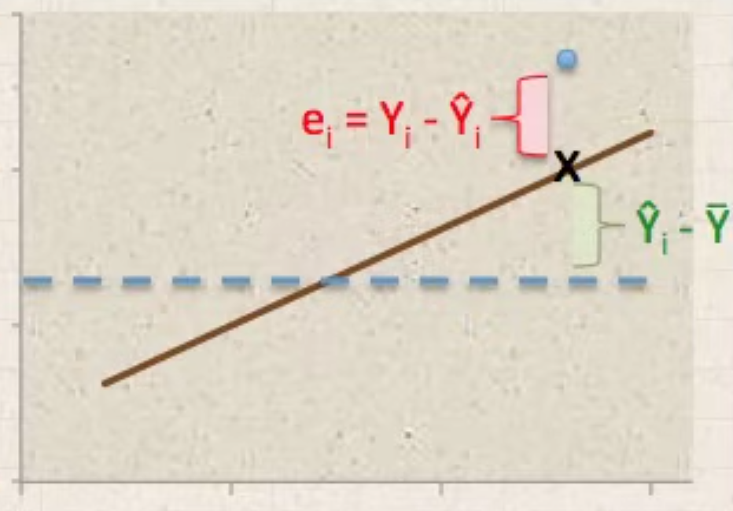
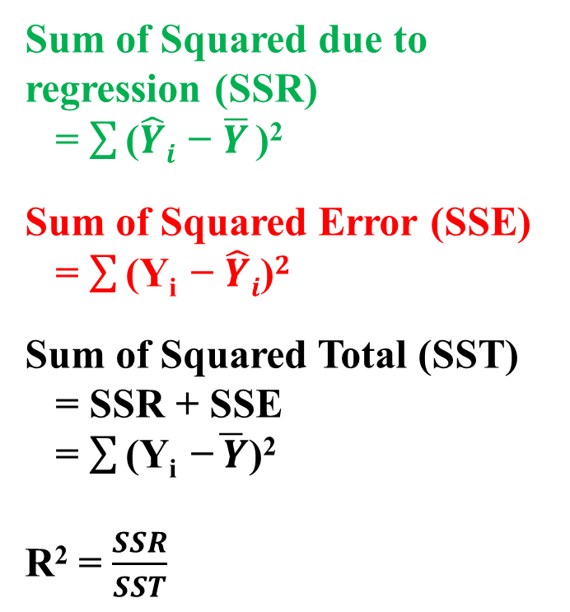
Sum of Squared due to regression (SSR)
= $\sum{\text{(}\hat{Y}i \text{− }\overline{Y} \text{)}\text{2} }$
Sum of Squared Error (SSE)
= $\sum{\text{(Y}\text{i } \text{− }\hat{Y}i\text{)}2}$
Sum of Squared Total (SST)
= SSR + SSE
= $\sum{\text{(Y}\text{i } \text{−}\overline{ Y}\text{)}\text{2} }$
R² = $\frac{SSR}{SST}$

Slide 4
Higher R² indicates better fit, whereas lower R² indicates poor fit.
Example, if R² = 0.80, 80% of the variation in the value of the dependent variable can be explained by the independent variables.

